Slide 1
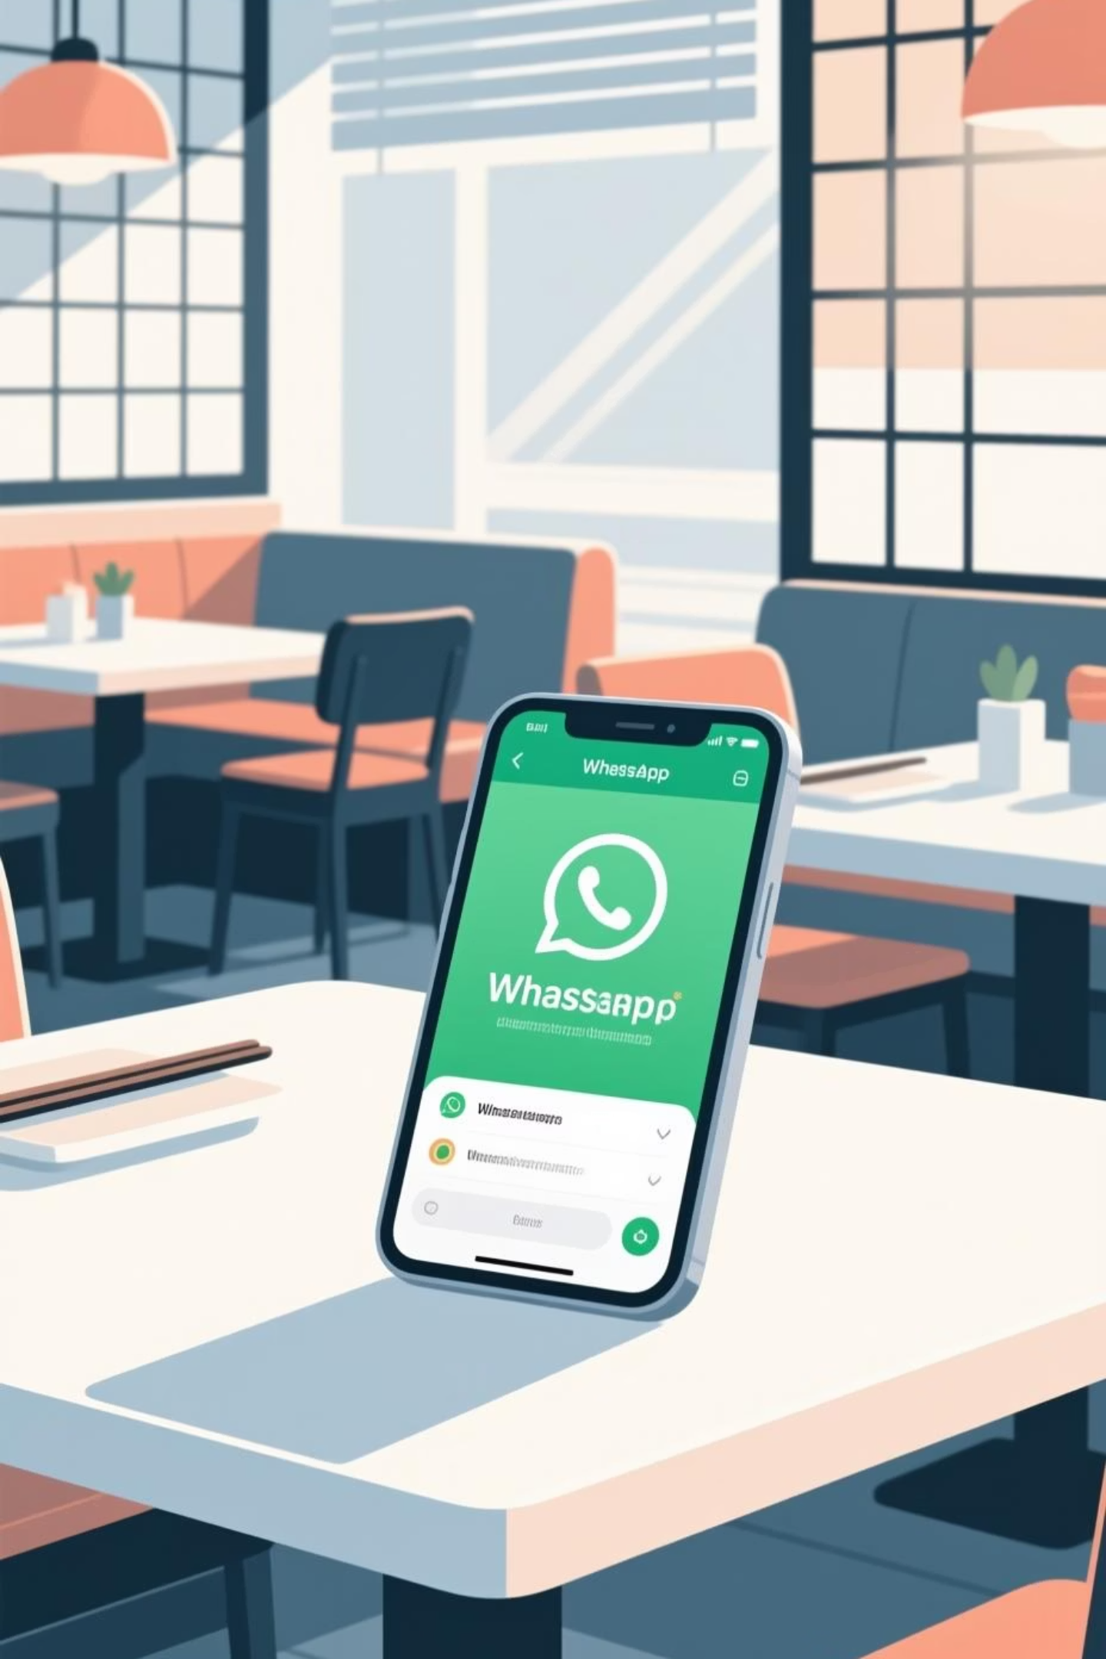
RR Restaurant WhatsApp AI Assistant
Revolutionising restaurant ordering with intelligent automation
By Rithwik Racharla

Slide 2

The Challenge We're Solving 🎯
Traditional Pain Points
Our Solution
Staff overwhelmed during peak hours managing phone calls
24/7 automated WhatsApp ordering assistant
AI-powered conversation handling
Order mistakes from miscommunication
Instant order logging to Google Sheets
Lost revenue from missed calls
Seamless customer experience
No automated order tracking system

Slide 3

System Architecture Overview 🏗️
Four core components working together to create a seamless ordering experience:
WhatsApp Integration
AI Processing Engine
Customer-facing messaging platform where orders are placed conversationally
Natural language understanding powered by OpenAI to interpret customer requests accurately
Google Sheets Database
n8n Automation
Real-time order logging and tracking system accessible to restaurant staff
Orchestration platform connecting all components seamlessly without code

Slide 4
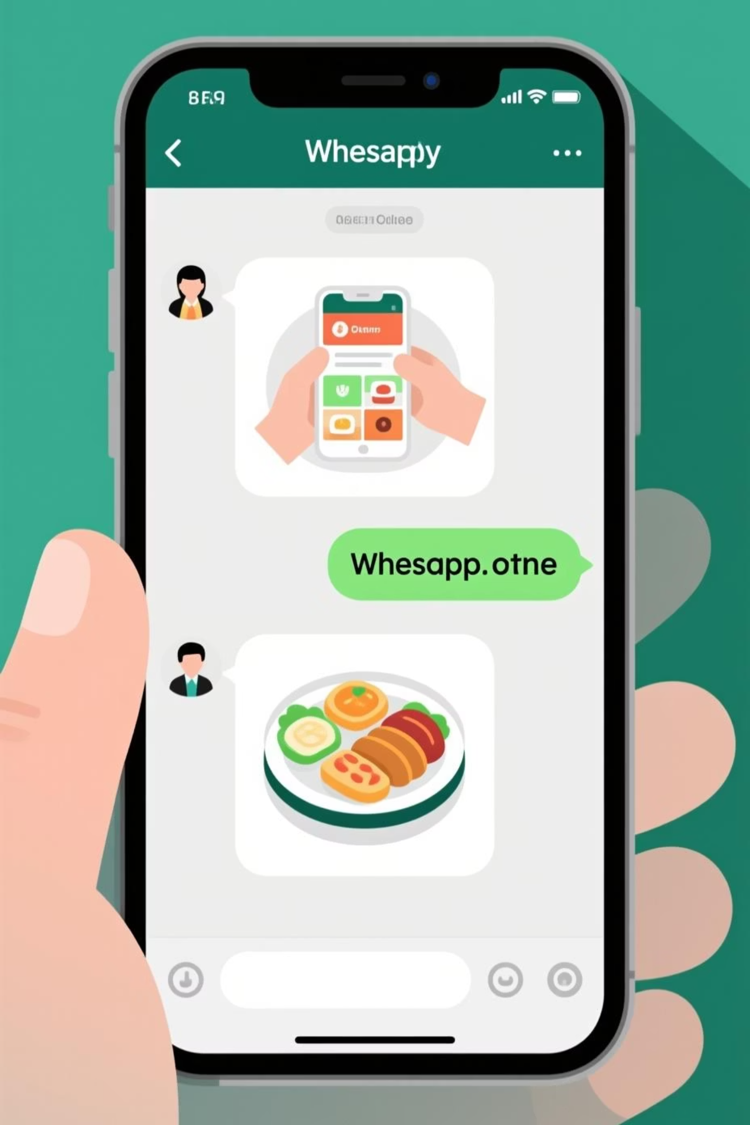




How It Works: Step-by-Step Process 📱
Customer Initiates Contact
Customer sends a WhatsApp message to the restaurant number with their order or enquiry
AI Processes Request
OpenAI analyses the message, understands intent, extracts order details, and crafts an appropriate response
Order Logged Automatically
Order details (items, quantity, customer info, timestamp) are instantly saved to Google Sheets
Confirmation Sent
Customer receives immediate confirmation via WhatsApp with order summary and estimated timing

Slide 5
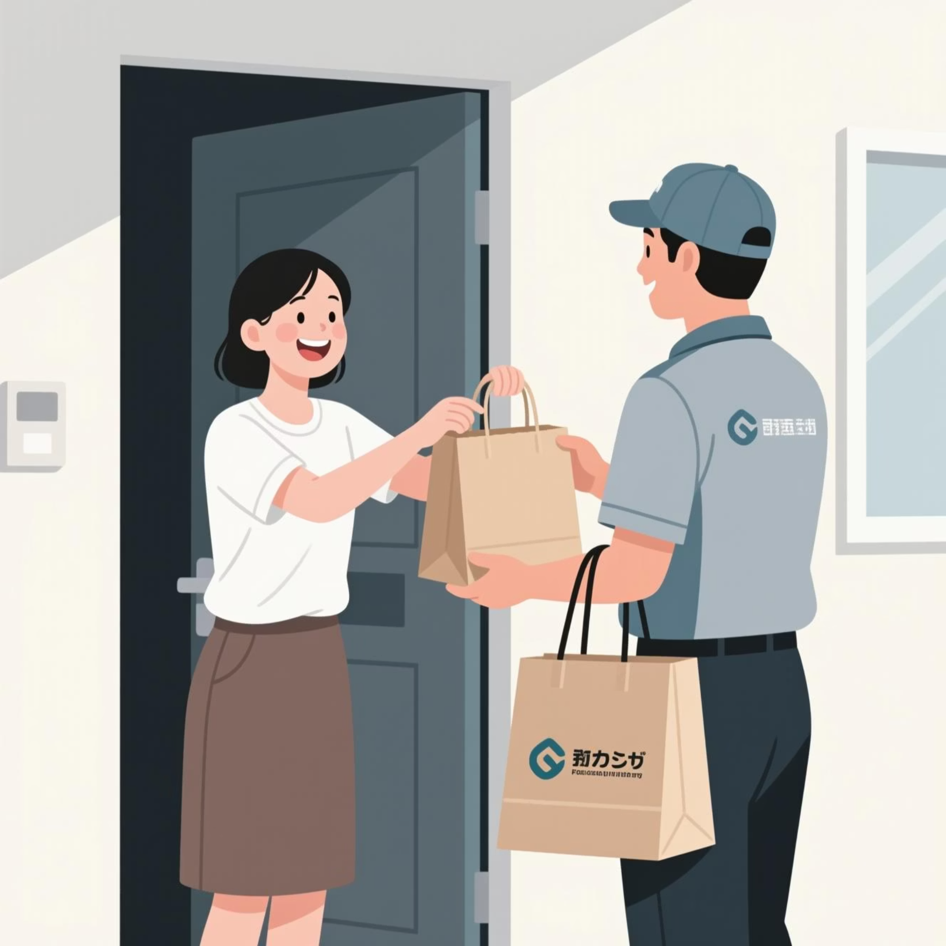
Real Customer Experience 🍕
Sample Conversation
Customer: "Hi! I'd like to order 2 Margherita pizzas and 1 Caesar salad for delivery to 123 High Street"
AI Assistant: "Perfect! I've received your order: 2x Margherita Pizza, 1x Caesar Salad. Delivery to 123 High Street. Total: £28.50. Expected delivery: 35-40 mins. Order #1247"
Behind the Scenes 🔧
Order #1247 instantly appears in Google Sheets
Kitchen staff receives notification
Customer can track order status
Complete audit trail maintained

Slide 6
Future Enhancements & Possibilities 🚀
Payment Integration
Multi-Language Support
Live Order Tracking
Accept payments directly through WhatsApp using Stripe or PayPal integration
Serve diverse communities by adding automatic translation capabilities
Real-time delivery updates with GPS integration and ETA notifications
Ready to transform your restaurant operations? This scalable solution grows with your business, handling unlimited orders whilst reducing operational costs. The future of restaurant ordering is here.

